Slide 1
Color basics
Terminology
and
Basic
concepts
for
Visual artists

Slide 2
This presentation will cover the following information.
References will refer generally to 2D art but are applicable to 3D media, equally.
What is Color?
Color Perception
The Color Wheel
Value and Color
Warm vs. Cool Color
Saturation and Intensity
Balance and Space
Color Schemes

Slide 3
Basic Terminology
Hue – the most general names for the visible spectrum as observed by Newton; there are many ‘colors’ but only a few ‘hues’.
Color wheel – a model for the study of color that expresses the difference in primary, secondary and tertiary color and sometimes value. There are many color wheels useful for differing purposes.
Tint – Color plus white
Shade – Color plus black
Color Scheme – a selected series of colors applied to an artwork or design to achieve particular optical effects and emotions.
Chroma – another word for color, sometimes used to refer to ‘saturation’: the purity and intensity of a color.
*either a tint OR a shade is a ‘desaturated’ color.
The hue Green
Colors of Green, yellow green, blue green, etc.
A tint of Green
A shade of green
Analogous Color Scheme
Saturated chroma of red
Desaturated chroma of red

Slide 4
The History of COLOR…..
Color is a phenomenon of light and your perception, it is NOT
A ‘thing’ unto itself.
How does color work?
Color is present within white light as various wavelengths of energy. When combined, we perceive them as ‘white’, but separated, we observe them as a spectrum with each wave function expressing a different color; some we see, some we do not.
Who discovered the phenomenon of color?
Rene Descartes, the French philosopher and scientist observed light dispersing into the color spectrum in the 16th century. But it is Isaac Newton that we credit with the definitive observation of the phenomenon, by passing light through a glass prism, in 1666.
Newton divided this spectrum into the 7 base colors, known by the anagram ROY G BIV…
Rene Descartes (1596-1650)
Sir Isaac Newton, 1643-1727

Slide 5
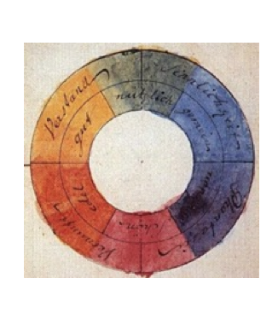
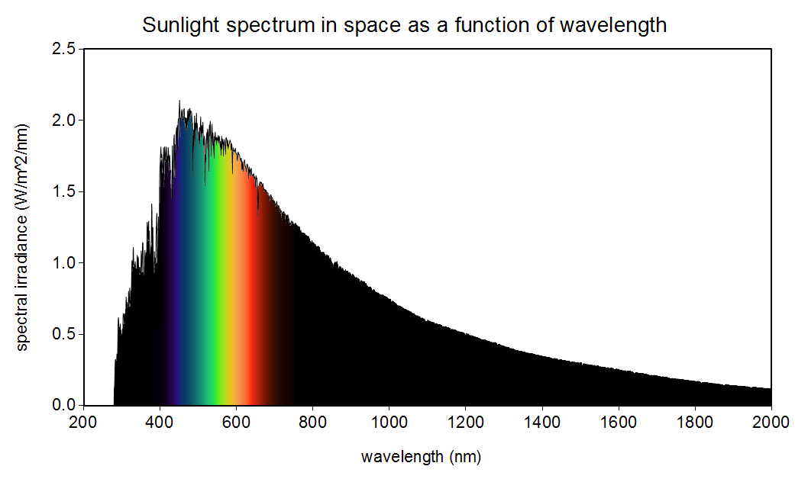



OR……..
Red
Orange
Yellow
Green
Blue
Indigo
Violet
……..BUT, besides the base 7 in the ‘visible spectrum’, there is a nearly continuous spectrum that we are simply unable to perceive.
Newton created the first Color Wheel to express the visible spectrum….
…and other theorists followed, with new interpretations…
What there actually is…
What we see…

Slide 6
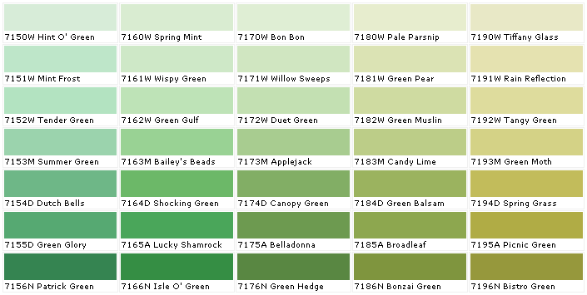



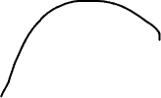



The Color Wheel Structure….
The modern color wheel was developed by Swiss born Johannes Itten in the 1920’s. Itten was a teacher at the Bauhaus School and developed his color theory course by combining earlier studies with his 12 point geometric system.
Center Triangle: the Primary colors – red, yellow, blue; these colors cannot be mixed from any other hues, which is why they are ‘primary’.
Next 3 Triangles: the Secondary colors – orange, green and purple made up of the combinations of the primary colors that they align with.
The outer ring consists of the Tertiary colors that sit between the Primary and Secondary in varying combinations.
Yellow + Blue (Primary) = Green (Secondary) and Green closer to Yellow is the Tertiary color Yellow Green, and to the opposite side, Blue Green. Of course, you can make a nearly infinite number of subtle gradations (and paint manufacturers do) especially when you include value.
Primary
Secondary
Tertiary

Slide 7
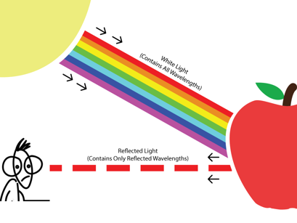
How do we see Color?
White light, containing all the wavelengths together, hits an object and some of the waves are absorbed; what is not absorbed is reflected back into the eye. Special cells (‘rods and cones’) at the back of the eye then ‘read’ the color wavelength and transmit that information to the brain.
…if there is an abnormality in the light sensitive cells of the eye, then the viewer experiences
‘color blindness’.
3 basic forms of color blindness…

Slide 8
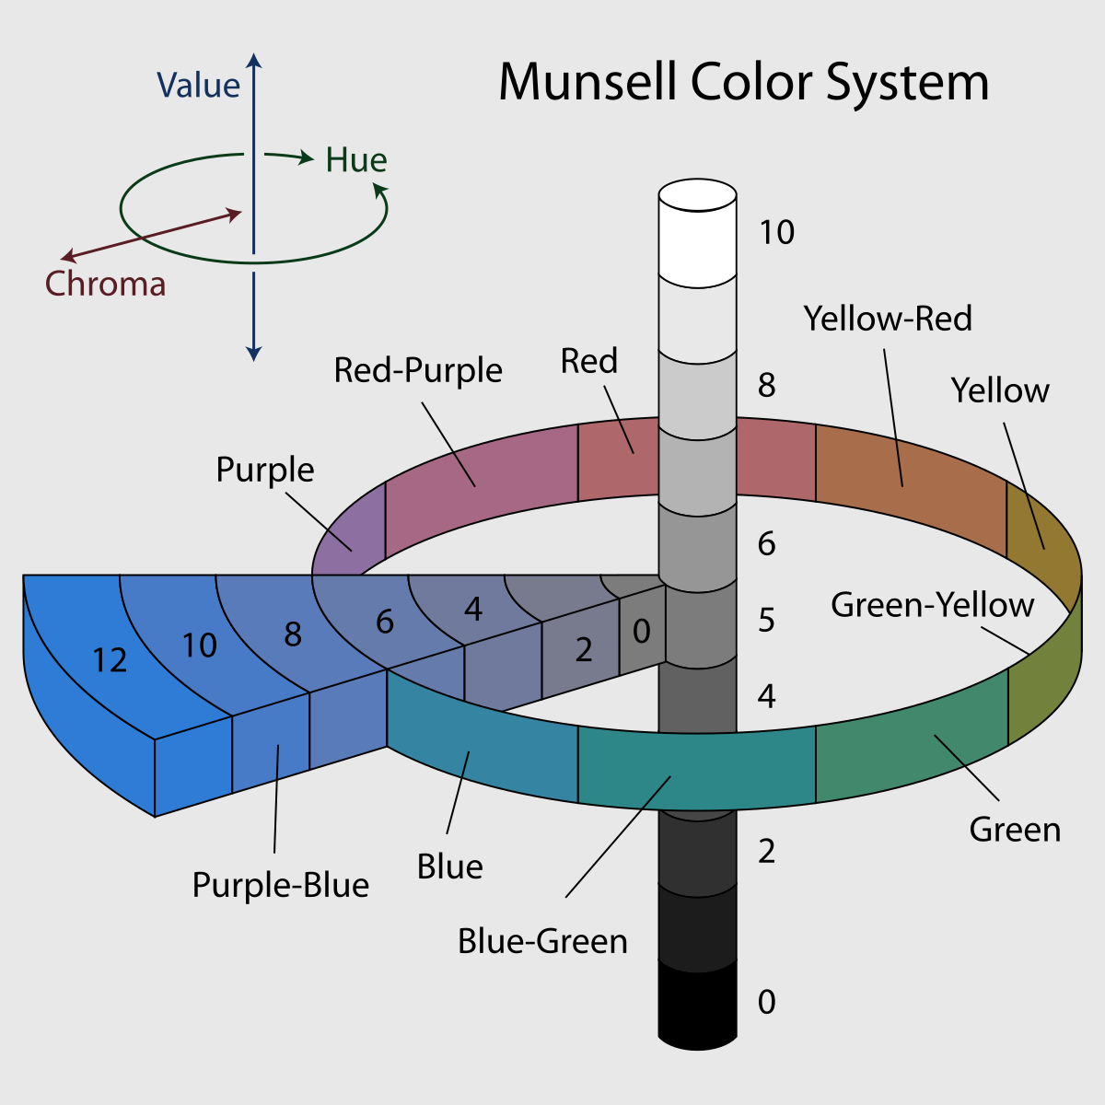
Color and Value…
All colors have intrinsic ‘value’, or, a level of relative lightness to darkness.
In the early 20th century, Albert Munsell developed the Munsell color system that included value, saturation as well as hue.
The value of the color can have radical effects on how the color interacts with others.
Example: Green is the opposite of Red
The two do not go together optically and create visual discord. But, by adjusting the value, a more pleasing and useful pairing is possible:
These are all tints and shades of the hue red but each with different value that significantly affects how they are perceived and function.

Slide 9
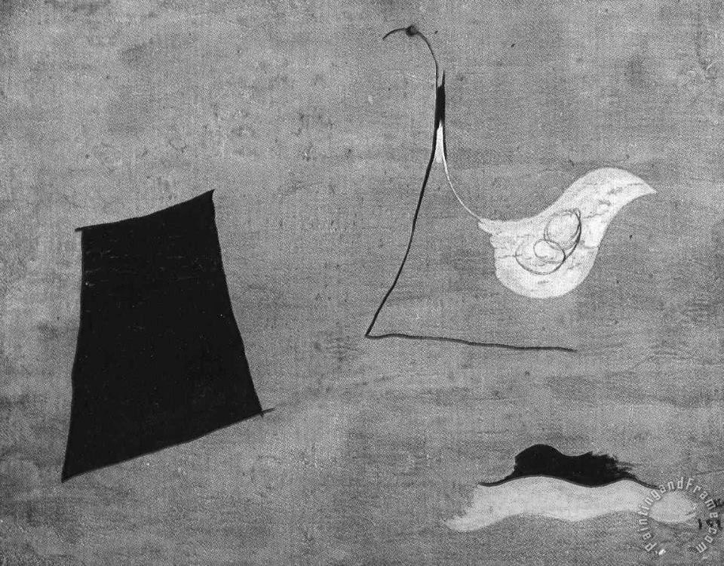
Color interaction and manipulation….
The perception of a color and its visual weight within a composition can be manipulated by:
Adjacent color (colors that surround the color)
Desaturation (via tint/shade or neutral grey)
Scale – more or less of a saturated color within a composition can alter balance and space.
Notice below how the yellow shape draws the eye so significantly from the larger black shape creating an asymetrical balance.
All of the green colors above are the same color; any perception otherwise is just the adjacent colors and values

Slide 10
Color and Space…
Color choices can help create the illusion of space and movement within an image.
Atmospheric Perspective is a visual illusion drawn from nature based on the diffusion of light, and therefore color, through the atmosphere.
In the image to the right observe how the foreground is darker, and more saturated while the mid and backgrounds move to lower saturation and less detail/contrast. Blue has the longest wavelength in the spectrum so as all other colors are filtered, blue-grey tones remain.
The phenomenon is just as
Convincing in Abstraction as it is in
Realism.
Foreground: saturated, darker, contrast, detail.
Background: desaturated, lighter, grey blue, less detail.

Slide 11
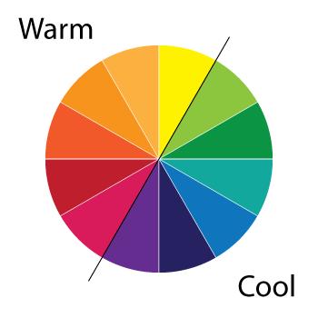
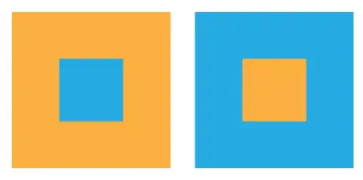
….color also has ‘temperature’ that can affect the perception of space and composition.
Colors can be divided basically between
Warm and Cool; warm colors will advance visually while cool colors will recede. Overlapping and atmospheric perspective increase this illusion.
Warm: red, orange, yellow
Cool: blue, purple, green
BUT….what if you make a cool color warmer, or vice versa?
The blue recedes, even in the center, while the yellow advances.
In this composition to the left, the colors are all the same, they’ve just been reversed in position. Notice how their scale and what they are closest to affects your perception.

Slide 12
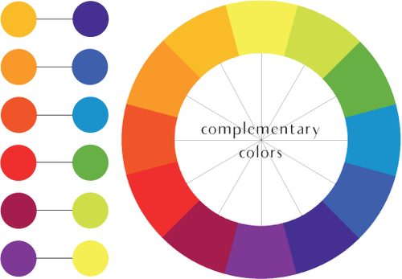
COLOR SCHEMES…
Color schemes can range from harmonious to discord, depending on the effect you are going for. In visual art, color schemes do NOT need to be ‘pretty’, they just need to be effective. So, there are a few RULES…
Complementary colors do NOT mix; these are opposite each other on the color wheel. The light sensitive cells in your eyes are assigned specific colors to receive and read (which is why not all color blindness is the same). Some wavelengths simply won’t mix with others – these are their ‘complements’.
Analogous colors are next to one another on the wheel and always harmonize.
The above rules can be bent to your will with the introduction of tints and shades making the ‘neutral greys’
Mixing the Complements…
*Neutral grey
a color made by mixing complements with additions of white or black
* Notice how the mixtures are not necessarily ‘ugly’ they are just desaturated, but also, interesting in their own ways.

Slide 13
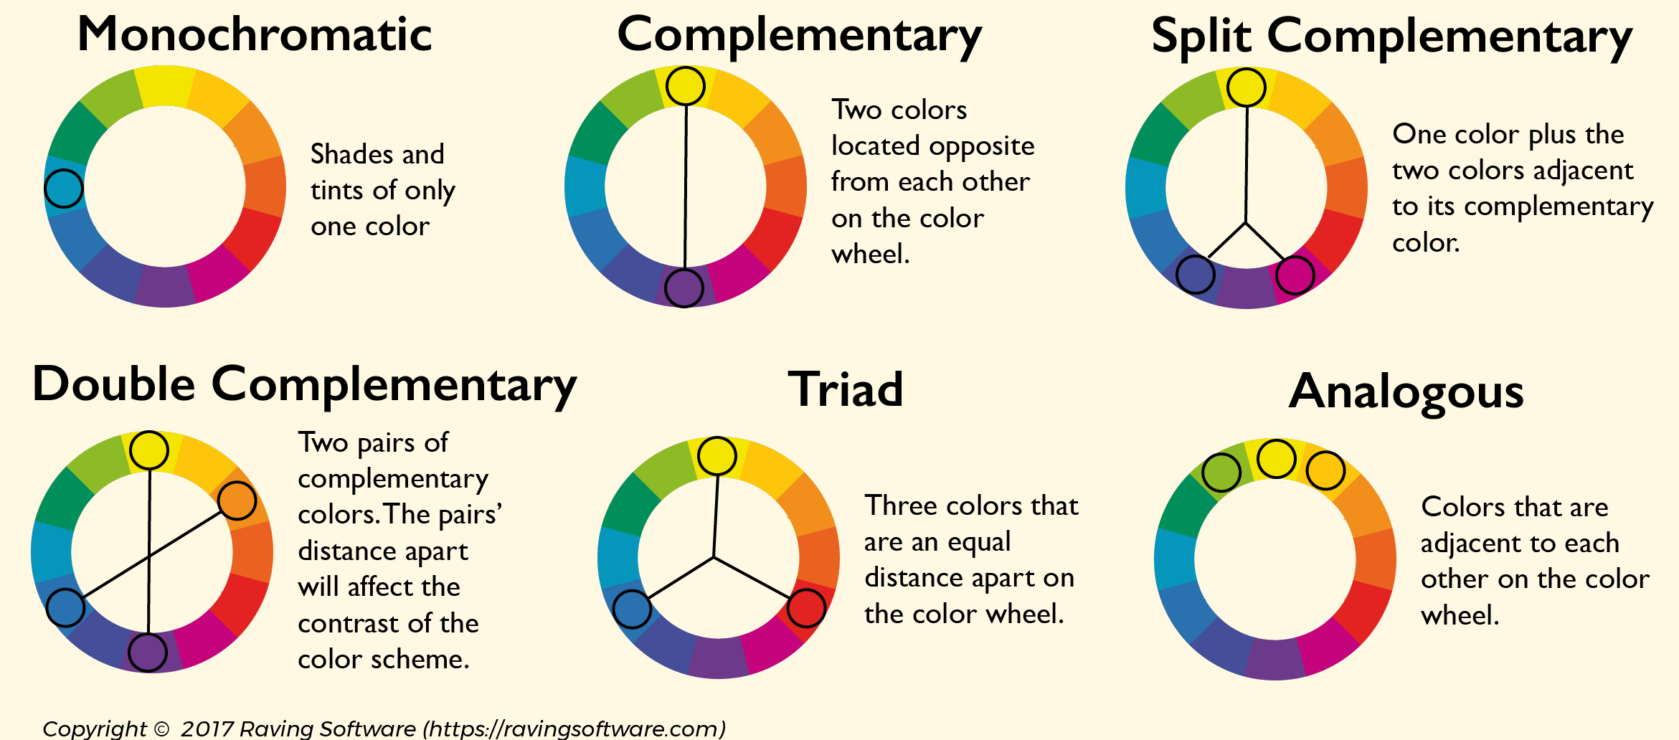
Besides complementary and analogous color schemes, there are many others. Adding tints and shades broadens the possibilities even further.

Slide 14
How does color feel?
It’s a matter of opinion, but also culture.
In the West, we have ‘royal’ purple for kings and queens, but in China, ‘imperial’ yellow was the color of choice for the divine ruler…
…a Hindu bride wouldn’t be caught dead in a white sari.
Because it’s a symbol of mourning!
…but again, in Myanmar and Egypt, yellow is for mourning…

Slide 15
It all depends on the message you are trying to send with your work.
Generally, the more ‘artificial’ a color the more energetic it feels, while the more ‘natural’ and muted a color, the more organic and relaxed it feels.
Dynamic? Modern? Energetic? – try complementary schemes for vibrating contrast.
Serene? Calm? Relaxing? – try Analogous schemes of greens and blues drawn from nature.
Realism? That’s ‘local color’ - whatever color it is, that’s what it is. Choose items with the color sensation you are after and arrange accordingly.
Realistic subject but who cares about realism? That’s ‘arbitrary color’.
Orange and blue vs. blues and greens
Wolf Khan is a master of the vibrant, arbitrary color scheme applied to the realistic subject. Its not about the landscape, its about the feeling of the landscape…

